Slide 1

Electrical Systems
Electricity can be dangerous. My nephew tried to stick a penny into a plug. Whoever said a penny doesn't go far didn't see him shoot across that floor. I told him he was grounded.
Tim Allen
Civil Engineering and Architecture
© 2010 Project Lead The Way, Inc.

Slide 2
TABLE OF CONTENTS
The Electrical System
Electric Service
Electric Power
Power Distribution
  Building wiring
  Receptacle
  Switches
Electrical Codes
Electrical Plans
Energy Conservation
Notes:
Civil Engineering and Architecture
Unit 2 – Lesson 2.3 – Residential Design
Project Lead the Way, Inc.
Copyright 2010
Electrical Systems

Slide 3
The Electrical System
Meter
Service panel
Building wiring
Electrical boxes, receptacles (outlets), and switches
Lights
Equipment powered by electricity
Other electrical systems
  Entertainment (cable, home theater, audio systems, etc.)
  Telecommunications (telephone, security systems, intercoms, etc.)
Notes:
Civil Engineering and Architecture
Unit 2 – Lesson 2.3 – Residential Design
Project Lead the Way, Inc.
Copyright 2010
Electrical Systems

Slide 4
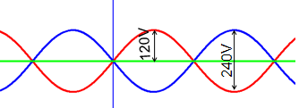
Electric Service
Electricity is supplied to a building via a service drop
  Three wires
  Two wires carry 120 volts of alternating current (AC) such that the voltages are opposite
  One wire is neutral or ground (zero volts)
Building electrical circuits powered by the difference between any two wires
  120V for most fixtures and appliances
    120V – 0V = 120V
  240V needed for certain applications and appliances
    120V – (-120V) = 240V
Notes:
Civil Engineering and Architecture
Unit 2 – Lesson 2.3 – Residential Design
Project Lead the Way, Inc.
Copyright 2010
Electrical Systems

Slide 5
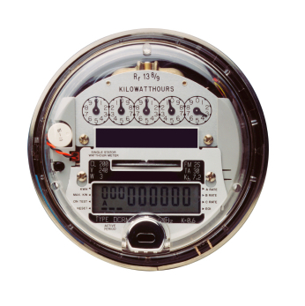
Electric Power
Power is the rate at which energy is used
Measured in watts
An electric meter measures electric power running through it
©iStockphoto.com
Notes:
Civil Engineering and Architecture
Unit 2 – Lesson 2.3 – Residential Design
Project Lead the Way, Inc.
Copyright 2010
Electrical Systems

Slide 6
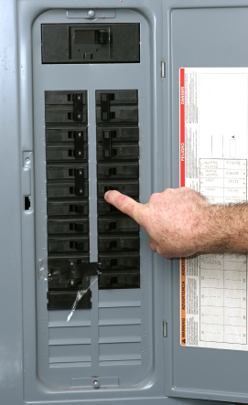
Power Distribution
Main breaker
Main Panel
  Power service supplied from meter
  Distributes power to the building
  Main breaker allows all power to be switched off
  Smaller circuit breakers allow individual circuits to be switched off
Circuit breakers
©iStockphoto.com
Notes:
Civil Engineering and Architecture
Unit 2 – Lesson 2.3 – Residential Design
Project Lead the Way, Inc.
Copyright 2010
Electrical Systems

Slide 7
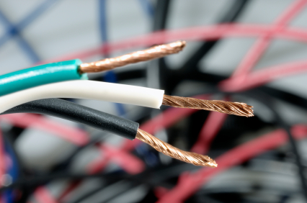
Building Wiring
Sheathed cables contain
  Black (other colors also used) hot wire
  White neutral wire
  Green (or bare) ground wire
Electricity is fed to a device via the hot wire and returns (completing the circuit) through the neutral wire
Ground wire provides a safe path for electricity if a short circuit accidentally occurs
©iStockphoto.com
Notes:
Civil Engineering and Architecture
Unit 2 – Lesson 2.3 – Residential Design
Project Lead the Way, Inc.
Copyright 2010
Electrical Systems

Slide 8
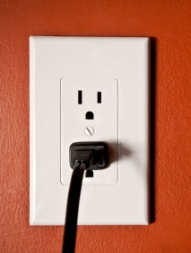
Receptacle
Neutral slot
An outlet to connect electrical devices to power
Allows continuation of circuit through hot, neutral, and ground wires in cord
Socket pattern corresponds to standard prong patterns
  Neutral slot longer than hot slot
  Grounding socket is rounded
Hot slot
Ground socket
©iStockphoto.com
Notes:
Civil Engineering and Architecture
Unit 2 – Lesson 2.3 – Residential Design
Project Lead the Way, Inc.
Copyright 2010
Electrical Systems

Slide 9
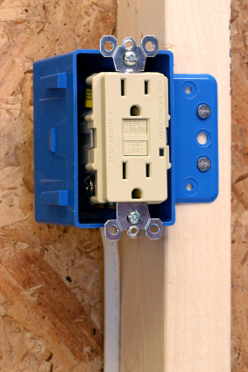
Ground-Fault Circuit Interrupter (GFCI)
Required by code in potentially wet locations
  Kitchen
  Bathroom
Circuit is opened (stops the current) when short circuit occurs
©iStockphoto.com
Notes:
Civil Engineering and Architecture
Unit 2 – Lesson 2.3 – Residential Design
Project Lead the Way, Inc.
Copyright 2010
Electrical Systems

Slide 10
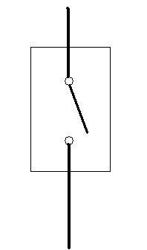
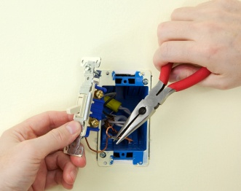
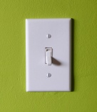
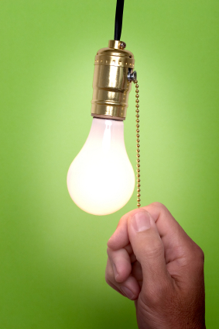
Single Pole Electrical Switch
Allows switching from one location
Typical installation
  Power comes into switch
  Switch toggles to open or close circuit
  Power travels to light or equipment
©iStockphoto.com
Notes:
When you toggle a single pole switch, you close the circuit when the switch is in the ON position (so that electricity flows to the light or device) and open the circuit when the switch is in the OFF position (so that no electricity flows).
[click] Each switch is housed in a switch box (the blue box in the image at the bottom).
Civil Engineering and Architecture
Unit 2 – Lesson 2.3 – Residential Design
Project Lead the Way, Inc.
Copyright 2010
Electrical Systems

Slide 11
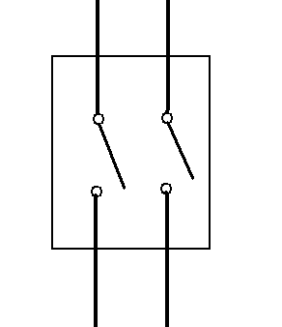
Double-Pole/Single-Throw Switch
Allows switching two circuits from one location
Similar to single-pole switch except two circuits are opened or closed with a single switch.
©iStockphoto.com
Notes:
When you toggle a single pole switch, you close the circuit in the ON position (so that electricity flows to the light or device) and open the circuit in the OFF position (so that no electricity flows).
Each switch is housed in a switch box (the blue box in the image at the bottom).
Civil Engineering and Architecture
Unit 2 – Lesson 2.3 – Residential Design
Project Lead the Way, Inc.
Copyright 2010
Electrical Systems

Slide 12
Three Way Electrical Switch
Allows switching a circuit from two locations
©iStockphoto.com
Notes:
Although the label “three way switch” indicates that three switches should be included, a three way switch is a switch that allows connection to a second switch and another device. Toggling either switch will turn the device ON or OFF.
Civil Engineering and Architecture
Unit 2 – Lesson 2.3 – Residential Design
Project Lead the Way, Inc.
Copyright 2010
Electrical Systems

Slide 13
Electrical Codes
Local jurisdictions may have unique electrical code requirements or may adopt a model code
International Residential Code includes residential electrical requirements
National Electrical Code (NFPA 70) is a model code that provides guidelines for the design of electrical systems
Notes:
Civil Engineering and Architecture
Unit 2 – Lesson 2.3 – Residential Design
Project Lead the Way, Inc.
Copyright 2010
Electrical Systems

Slide 14
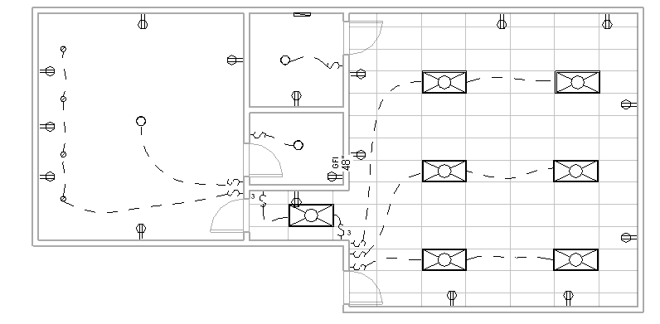
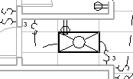
Electrical Plans
Notes:
This electrical plan illustrates how the electrical design is often documented using an electrical plan. An electrical plan identifies the electrical and lighting fixtures to be installed in a building.
The dashed lines [click] are switch legs which represent the wiring between a switch and the electrical component that it controls. In this design all of the lights are controlled by switches. Outlets or other hard-wired equipment can also be controlled by a switch.
[click] Note the use of single switches in most cases, except where two switches control the same light or group of lights where a three way switch is used. A small 3 next to the switch symbols indicates a three way switch.
[click] If the electrical installations are not complicated, the electrical plans can be placed directly on the floor plan. Often a separate electrical plan will show all electrical fixtures and light fixtures; however, for more complicated commercial and industrial designs, the designer will create separate power plans and lighting plans. The power plan may show wiring for electrical outlets and electrical equipment. The lighting plan typically shows the light fixtures and switches.
Civil Engineering and Architecture
Unit 2 – Lesson 2.3 – Residential Design
Project Lead the Way, Inc.
Copyright 2010
Electrical Systems

Slide 15
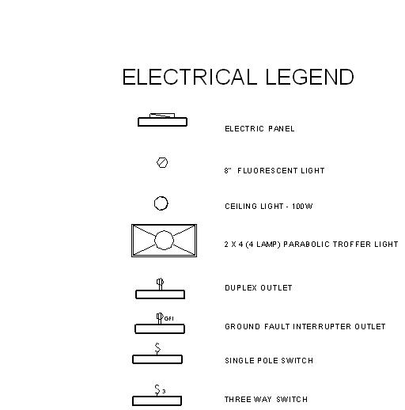
Legends
Notes:
Legends are keys that identify symbols used on a drawing view. This legend identifies the electrical and lighting fixtures used on the previous electrical plan.
Civil Engineering and Architecture
Unit 2 – Lesson 2.3 – Residential Design
Project Lead the Way, Inc.
Copyright 2010
Electrical Systems

Slide 16
Energy Conservation
Minimize electrical outlets and recessed appliances in exterior walls
Install timed switches or a humidistat in exhaust fans to control unnecessary ventilation
Select energy efficient appliances and equipment
Use energy efficient fluorescent lighting where practical
Use recessed lighting fixtures that are rated for insulation cover
Notes:
Some tips to provide energy savings when designing an electrical system.
Civil Engineering and Architecture
Unit 2 – Lesson 2.3 – Residential Design
Project Lead the Way, Inc.
Copyright 2010
Electrical Systems

Slide 17
TABLE OF CONTENTS
The Electrical System
Electric Service
Electric Power
Power Distribution
  Building wiring
  Receptacle
  Switches
Electrical Codes
Electrical Plans
Energy Conservation
Notes:
Civil Engineering and Architecture
Unit 2 – Lesson 2.3 – Residential Design
Project Lead the Way, Inc.
Copyright 2010
Electrical Systems

Slide 18
Image Resources
Retrieved December 12, 2009 from www.istock.com
Retrieved December 12, 2009 from www.wikimedia.com
Notes:
Civil Engineering and Architecture
Unit 2 – Lesson 2.3 – Residential Design
Project Lead the Way, Inc.
Copyright 2010
Electrical Systems

Slide 19
Electrical Systems
Notes:
Civil Engineering and Architecture
Unit 2 – Lesson 2.3 – Residential Design
Project Lead the Way, Inc.
Copyright 2010
Electrical Systems

